Slide 1
GETTING STARTED WITH
DISTRIBUTED TRAINING AT SCALE
SUMAN DEBNATH, ANYSCALE

Slide 3
Why we need to distribute our Training ?

Slide 4


Model
Data

Slide 5
Model
Data

Slide 6
Model
Model
Model
Model
Data
Data
Data
Data

Slide 7
Model
Model
Model
Model
Parameters
Gradients
Optimizer States
Data
Data
Data
Data

Slide 8
Model
Model
Model
Model
Parameters
Parameters
Parameters
Parameters
Gradients
Gradients
Gradients
Gradients
Optimizer States
Optimizer States
Optimizer States
Optimizer States
Data
Data
Data
Data

Slide 9

Model
Model
Model
Model
Parameters
Parameters
Parameters
Parameters
Gradients
Gradients
Gradients
Gradients
Optimizer States
Optimizer States
Optimizer States
Optimizer States
Forward

Slide 10

Model
Model
Model
Model
Parameters
Parameters
Parameters
Parameters
Gradients
Gradients
Gradients
Gradients
Optimizer States
Optimizer States
Optimizer States
Optimizer States
Forward
Backward

Slide 11
Model
Model
Model
Model
Parameters
Parameters
Parameters
Parameters
Gradients
Gradients
Gradients
Gradients
Optimizer States
Optimizer States
Optimizer States
Optimizer States
Forward
Backward

Slide 12

Model
Model
Model
Model
Parameters
Parameters
Parameters
Parameters
Gradients
Gradients
Gradients
Gradients
Optimizer States
Optimizer States
Optimizer States
Optimizer States
Forward
Backward
All-Reduce

Slide 13

Model
Model
Model
Model
Parameters
Parameters
Parameters
Parameters
Gradients
Gradients
Gradients
Gradients
Optimizer States
Optimizer States
Optimizer States
Optimizer States
Forward
Backward
All-Reduce

Slide 14
Model
Model
Model
Model
Parameters
Parameters
Parameters
Parameters
Gradients
Gradients
Gradients
Gradients
Optimizer States
Optimizer States
Optimizer States
Optimizer States

Slide 15
Model
Model
Model
Model
Parameters
Parameters
Parameters
Parameters
Gradients
Gradients
Gradients
Gradients
Optimizer States
Optimizer States
Optimizer States
Optimizer States
And it continues with a new batch of data

Slide 16
Model
Model
Model
Model
Parameters
Parameters
Parameters
Parameters
Gradients
Gradients
Gradients
Gradients
Optimizer States
Optimizer States
Optimizer States
Optimizer States
Distributed Data Parallel (DDP)

Slide 17
Model
Parameters
Gradients
Optimizer States
What if the Model doesn’t fit ?

Slide 18
Model
Parameters
Gradients
Optimizer States
What if the Model doesn’t fit ?
We have many options...

Slide 19
Model
Parameters
Gradients
Optimizer States

Slide 20
Model
Model
Model
Model
Parameters
Parameters
Parameters
Parameters
Gradients
Gradients
Gradients
Gradients
Optimizer States

Slide 21
Model
Model
Model
Model
Parameters
Parameters
Parameters
Parameters
Gradients
Gradients
Gradients
Gradients

Slide 22
Model
Model
Model
Model
Parameters
Parameters
Parameters
Parameters
Gradients
Gradients
Gradients
Gradients
ZeRO-1
optimizer state partitioning

Slide 23
Model
Model
Model
Model
Parameters
Parameters
Parameters
Parameters
Gradients
Gradients
Gradients
Gradients
Can we optimize further ?

Slide 24
Model
Model
Model
Model
Parameters
Parameters
Parameters
Parameters

Slide 25
Model
Model
Model
Model
Parameters
Parameters
Parameters
Parameters
ZeRO-2
optimizer state + gradient partitioning

Slide 26
Model
Model
Model
Model
Parameters
Parameters
Parameters
Parameters
Can we still optimize more?

Slide 27
Model
Model
Model
Model

Slide 28
Model
Model
Model
Model
ZeRO-3
optimizer state + gradient + parameter partitioning

Slide 29

Model
Model
Model
Model
ZeRO-3
FSDP
optimizer state + gradient + parameter partitioning
FSDP (Fully Sharded Data Parallelism)

Slide 30
ZeRO-3
FSDP
FSDP (Fully Sharded Data Parallelism)
optimizer state + gradient + parameter partitioning
Model
Model
Model
Model
Parameters
Gradients
Optimizer States

Slide 31
ZeRO-3
FSDP
FSDP (Fully Sharded Data Parallelism)
optimizer state + gradient + parameter partitioning
Sequentially go through the layers, we retrieve the necessary parameters on demand
Model
Model
Model
Model
Parameters
Gradients
Optimizer States
Forward

Slide 32
ZeRO-3
FSDP
FSDP (Fully Sharded Data Parallelism)
optimizer state + gradient + parameter partitioning
Sequentially go through the layers, we retrieve the necessary parameters on demand
Model
Model
Model
Model
Parameters
Gradients
Optimizer States
Forward
Ψ
All-Gather

Slide 33
ZeRO-3
FSDP
FSDP (Fully Sharded Data Parallelism)
optimizer state + gradient + parameter partitioning
Sequentially go through the layers, we retrieve the necessary parameters on demand
immediately flush them from memory when we don't need them anymore
Model
Model
Model
Model
Parameters
Gradients
Optimizer States
Forward
Ψ

Slide 34
ZeRO-3
FSDP
FSDP (Fully Sharded Data Parallelism)
optimizer state + gradient + parameter partitioning
Works the same way, just inverted in flow
Model
Model
Model
Model
Parameters
Gradients
Optimizer States
Forward
Backward
Ψ

Slide 35
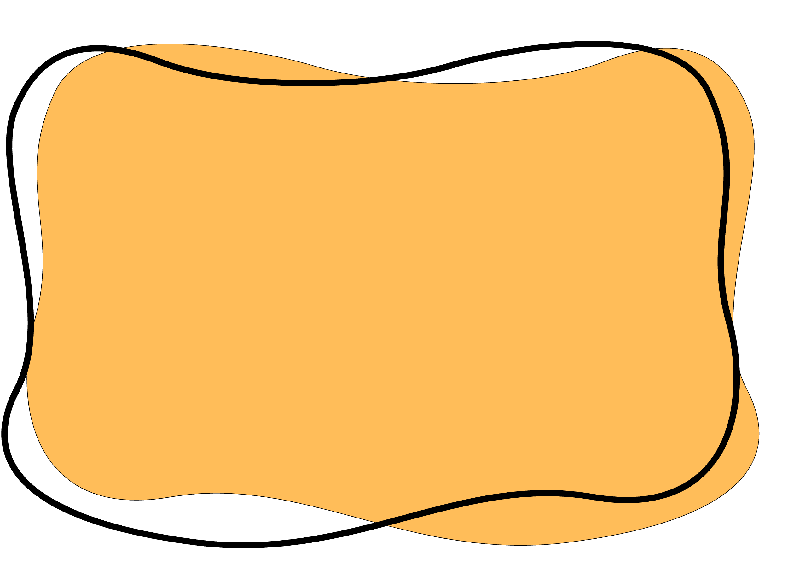
ZeRO-3
FSDP
FSDP (Fully Sharded Data Parallelism)
optimizer state + gradient + parameter partitioning
Works the same way, just inverted in flow
we do all-gather operations for the parameters
Model
Model
Model
Model
Parameters
Gradients
Optimizer States
Forward
Backward
Ψ
Ψ
All-Gather

Slide 36
ZeRO-3
FSDP
FSDP (Fully Sharded Data Parallelism)
optimizer state + gradient + parameter partitioning
Works the same way, just inverted in flow
produce the gradient shards
Model
Model
Model
Model
Parameters
Gradients
Optimizer States
Forward
Backward
Ψ
Ψ
Reduce-scatter
Ψ

Slide 37

ZeRO-3
FSDP
FSDP (Fully Sharded Data Parallelism)
optimizer state + gradient + parameter partitioning
Model
Model
Model
Model
Parameters
Gradients
Optimizer States
Total Communication Tax
Forward
Backward
Ψ + Ψ + Ψ = 3 Ψ

Slide 38
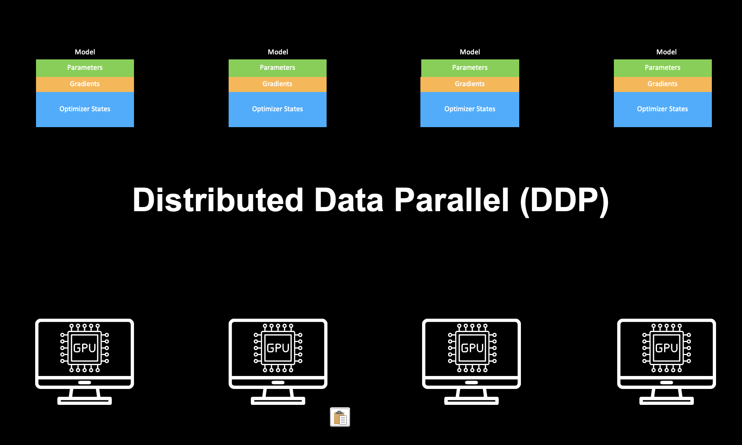
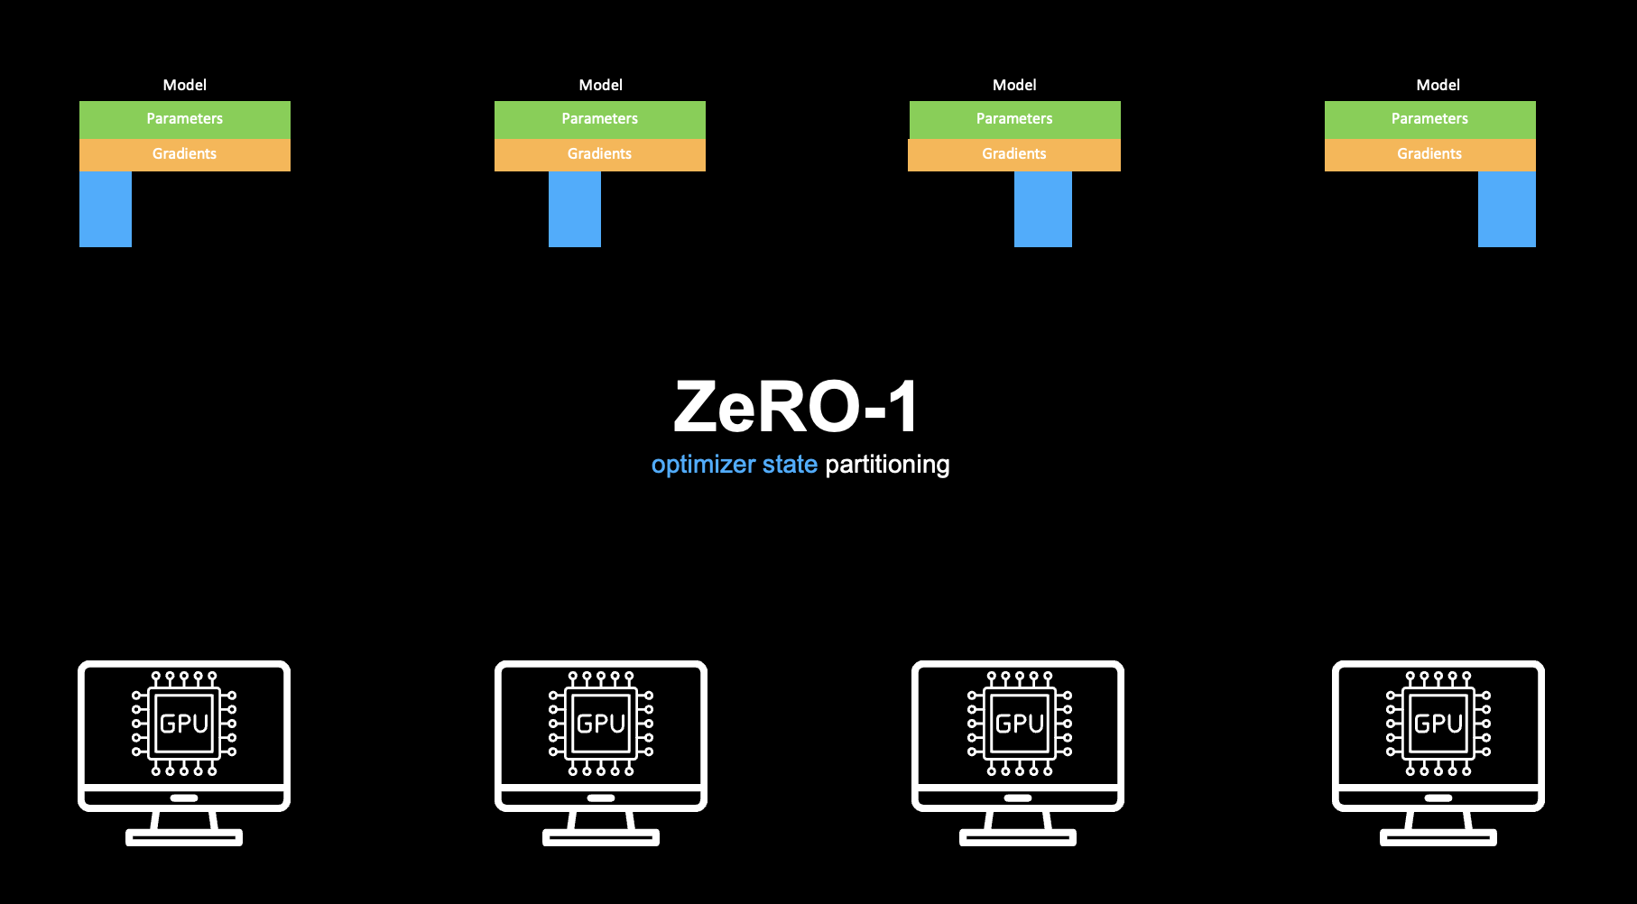
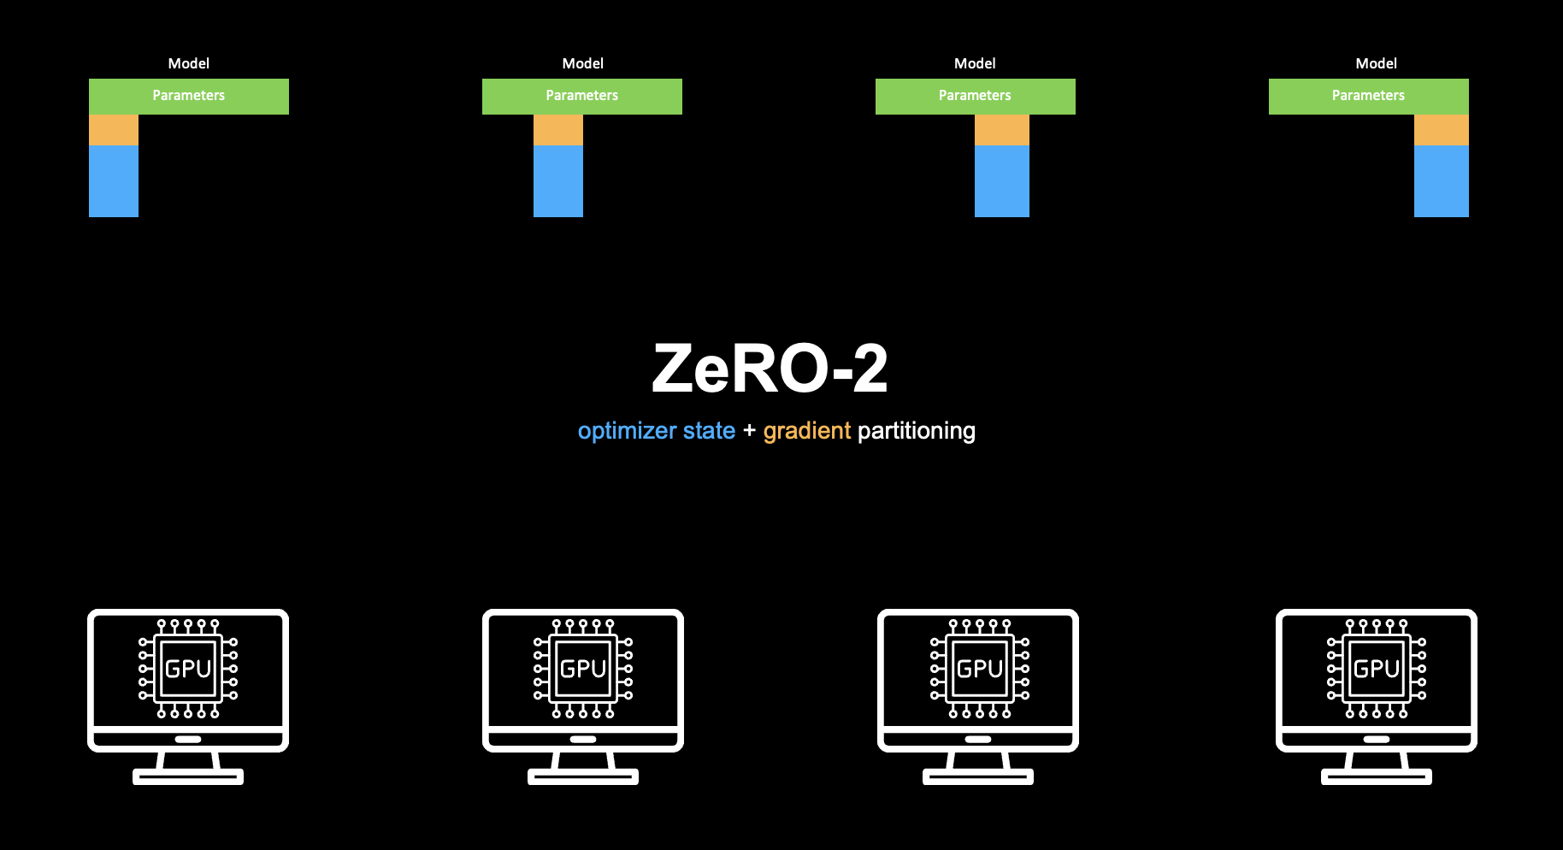
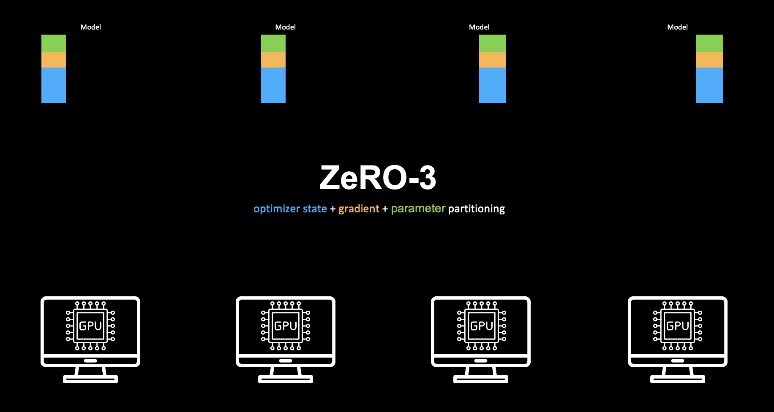

Slide 39
Data Parallel

Slide 40
Data Parallel
Each GPU still computes the full model forward and backward on its batch of data
Conceptually identical to Data Parallelism.

Slide 41
Data Parallel
Each GPU still computes the full model forward and backward on its batch of data
Conceptually identical to Data Parallelism.
What they do change is how the model’s parameters are stored in memory across GPUs.

Slide 42
Can we scale further ?
Data Parallel
Each GPU still computes the full model forward and backward on its batch of data
Conceptually identical to Data Parallelism.
What they do change is how the model’s parameters are stored in memory across GPUs.

Slide 43
Tensor Parallel
Pipeline Parallel
Expert Parallel
...
Data Parallel
Each GPU still computes the full model forward and backward on its batch of data
Conceptually identical to Data Parallelism.
What they do change is how the model’s parameters are stored in memory across GPUs.

Slide 44

RAY
Notes:
Ray is a distributed compute engine

Slide 45
RAY
Unifies the AI ecosystem
Notes:
…which unifies the AI ecosystem.

Slide 46
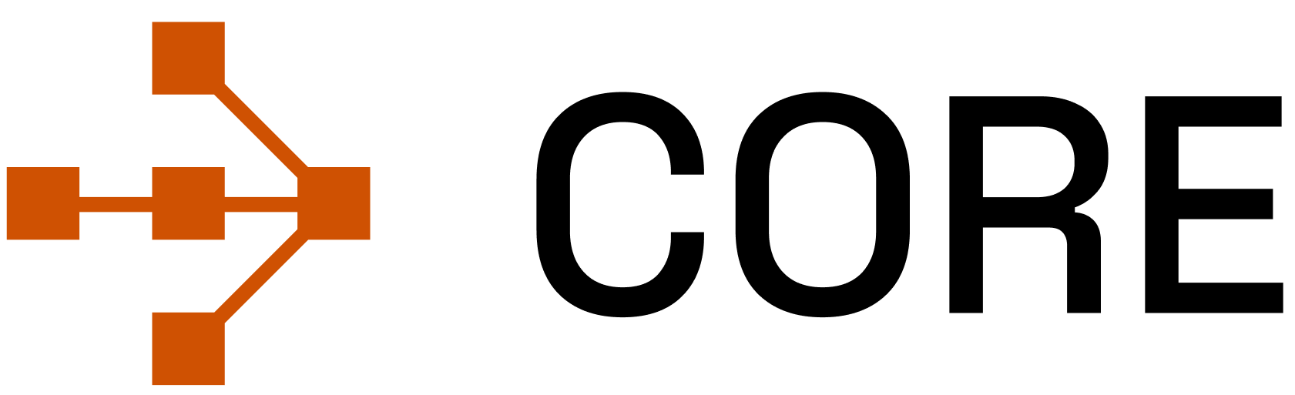
Core
Unifies the AI ecosystem
Notes:
At its core we have Ray Core, which is the compute engine.
Which you can use to scale any Python Code across 100s and 1000s of machine at scale with CPU, GPU and other accelerators.

Slide 47
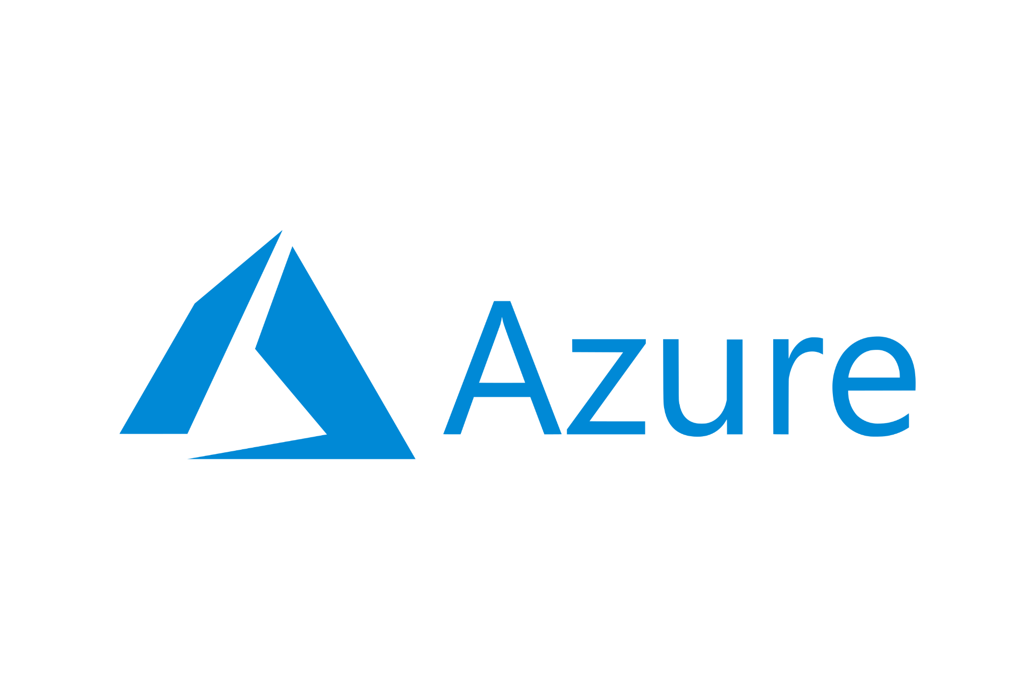
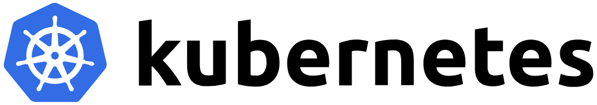





Core
Unifies the AI ecosystem
Runs wherever your hardware is
Notes:
It can run on any hardware of your choice, be it on cloud or on premise or even on your laptop.

Slide 48
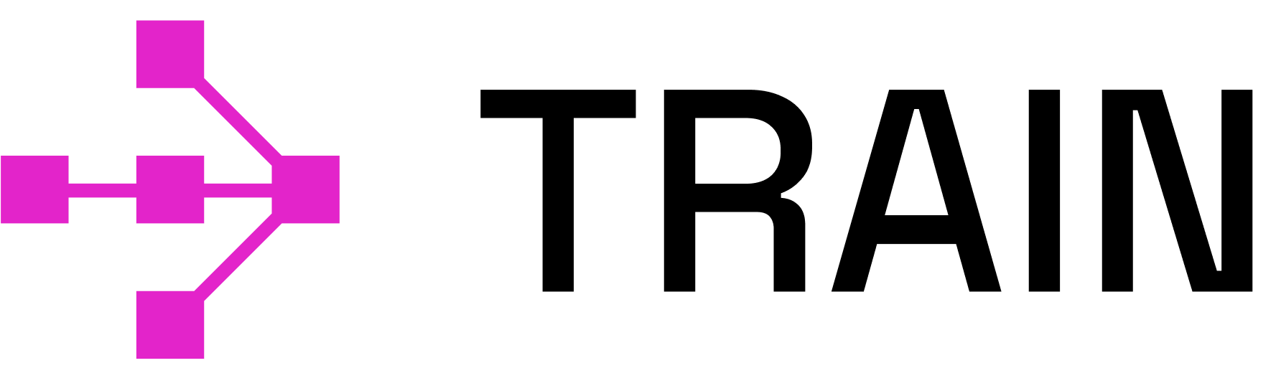

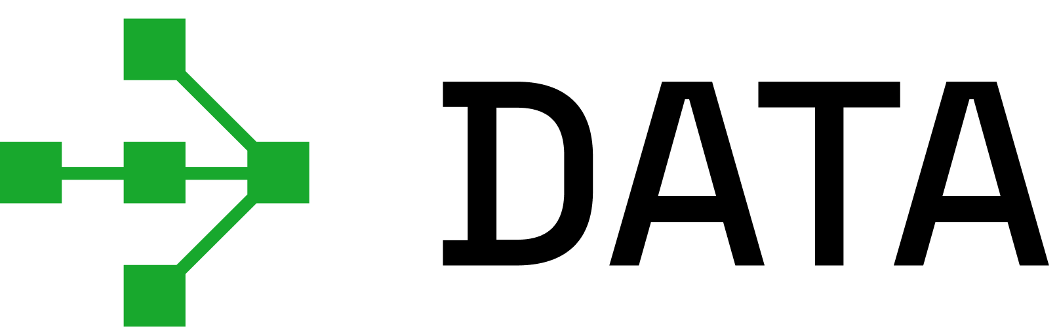

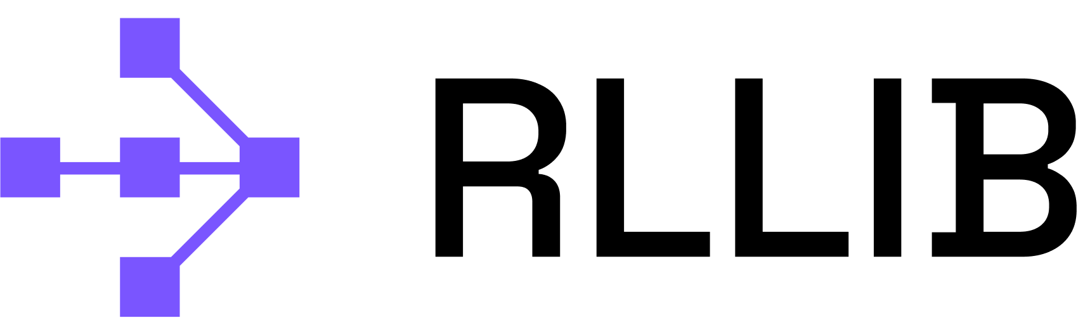
Ray Native Libraries
Serve
Train
Empowers AI/ML practitioners
RLlib
Data
Tune
Core
Unifies the AI ecosystem
Runs wherever your hardware is
Notes:
We have many different libraries for different AI workload, like
Ray Train for Distributed Training
Ray Data for Multimodal Data processing
Ray Server for Large Scale inference
and so on ….

Slide 49

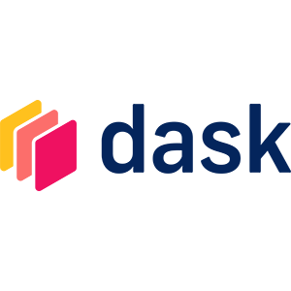



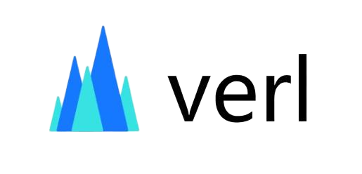
Ray Native Libraries
Integrated Ecosystem
Serve
Train
Empowers AI/ML practitioners
RLlib
Data
Tune
Core
Unifies the AI ecosystem
Runs wherever your hardware is
Notes:
Not only that, Ray can be used with different framework and engines, like PyTorch, Hugging Face, vLLM, etc.

Slide 50

Ray Native Libraries
Integrated Ecosystem
Train
Empowers AI/ML practitioners
Let’s take an example with PyTorch and Ray Train
Core
Unifies the AI ecosystem
Runs wherever your hardware is
Notes:
For this demo, we will use PyTorch and Ray Train and will see how we can perform a Distributed Training with them at scale.

Slide 51
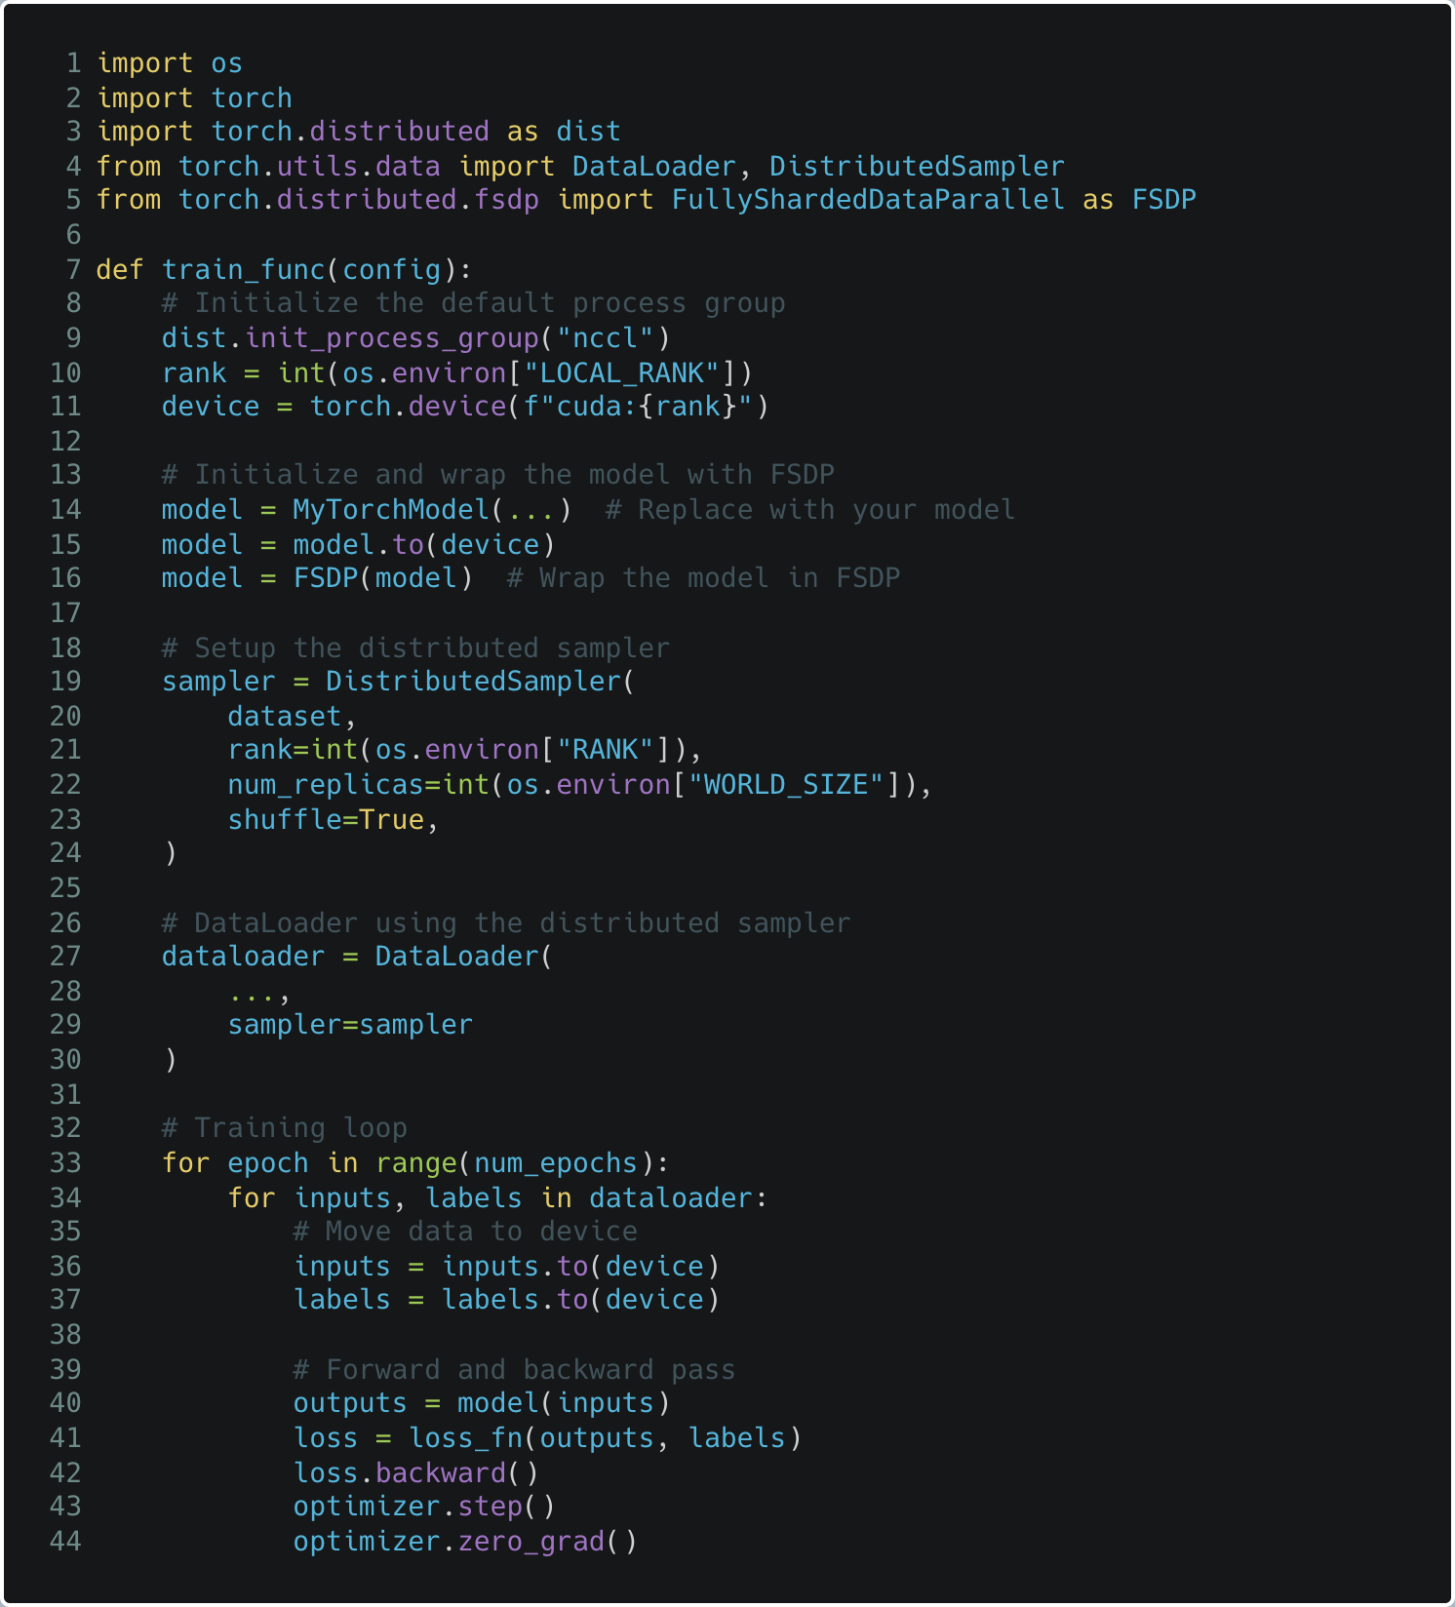
Setup
distributed env
Setup
FSDP model
Setup
distributed sampler
Move
batches to GPU
Notes:
Before we see Ray Train and its value, lets see how you would typically perform this distributed training using PyTorch
First, you need to define the training function which you expect to all your machines and GPUs and you do that by setting up “Initializing a Process Group” as you can see in line # 9

Slide 52
Setup
distributed env
Setup
FSDP model
Setup
distributed sampler
Move
batches to GPU
Notes:
Then you prepare your model, like in this case we want to use FSDP so we are wrapping our model with FSDP implementation of PyTorch as you can see in line #16

Slide 53
Setup
distributed env
Setup
FSDP model
Setup
distributed sampler
Move
batches to GPU
Notes:
And then we need to prepare the dataloader as we it’s a distributed training, we can not send the dataloader directly to the training function
But we need to wrap it around ”DistributedSampler” which tells PyTorch that this is a distributed training and it should distributed different micro-batch to different GPUs as Suman mentioned earlier while explaining different data parallel techniques

Slide 54
Setup
distributed env
Setup
FSDP model
Setup
distributed sampler
Move
batches to GPU
Notes:
Lastly you just run the training

Slide 55
Setup
distributed env
Setup
FSDP model
Setup
distributed sampler
Let’s see how it works with Ray Train
Train
Move
batches to GPU
Notes:
Lets see how things changes with Ray Train

Slide 56

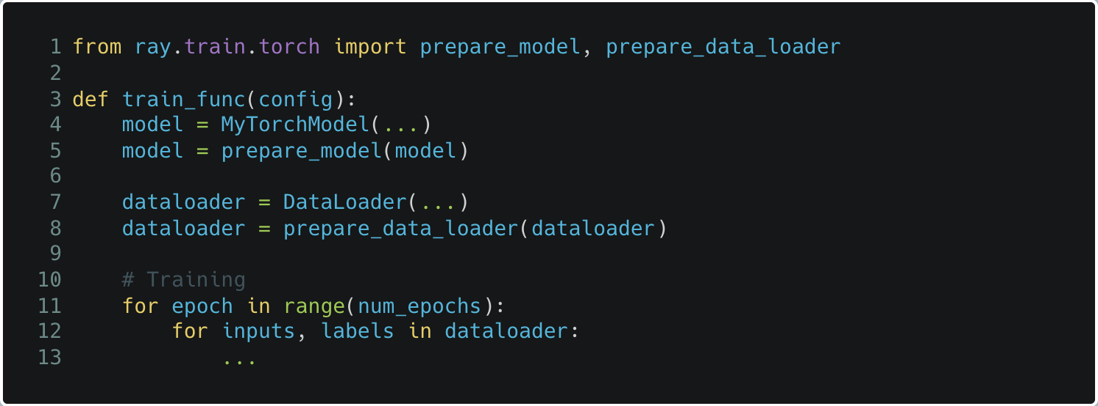
Setup
distributed env
Setup
FSDP model
Setup
distributed sampler
Let’s see how it works with Ray Train
Train
Move
batches to GPU
Notes:
With Ray Train, you first import ”prepare_model” and “prepare_data_loader” from Ray Train as you can see in line #1
And prepare your model and dataset with them,
As you can see there is no need to use Distributed Sampler separately, Ray Train would take care of that under the hood.

Slide 57

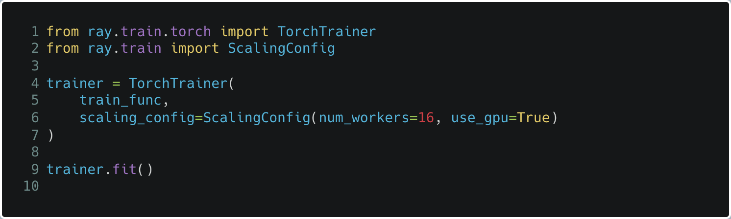
Setup
distributed env
Setup
FSDP model
Setup
distributed sampler
Let’s see how it works with Ray Train
Train
Move
batches to GPU
Notes:
And finally, you put both of them together within “TorchTrainer” by mentioned some sonfiguration details like ScalingConfig here where you specify how you want to scale and if you would like to use GPU or not.
For example, here we are saying to run this training in 16 workers with 1 GPU in each worker.

Slide 58
But what is happening under the hood ?
Let’s see how it works with Ray Train
Train
Notes:
But wht is happening under the hood ? Lets take a look what ray is doing here once we start the training and run “trainer.fit()”

Slide 59
Training Function
Notes:
Let’s say this is our training function which we want our FSDP to run in all the workers

Slide 60
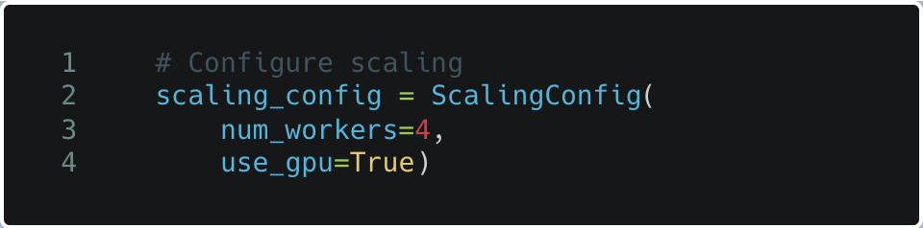
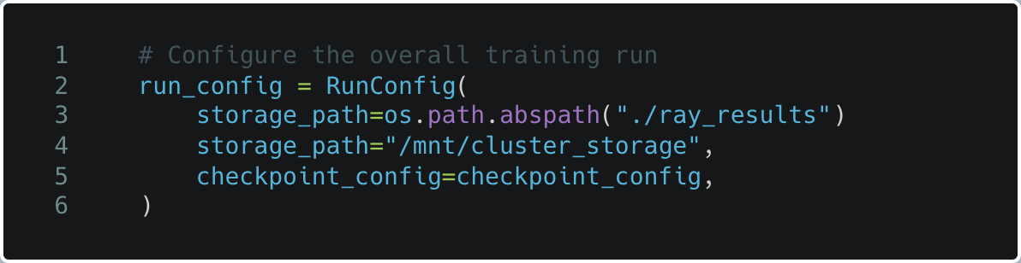
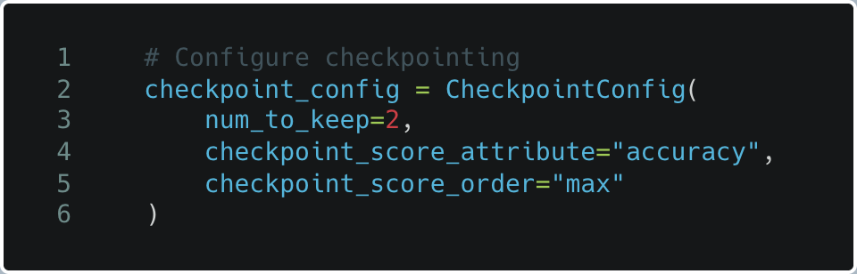
Training Function
Scaling Configuration
Running Configuration
Checkpoint Configuration
Notes:
And here are the different configuration details which we need to provide to Ray, like Scaling Configuration like we saw a while back and other configurations like checkpointing, etc.

Slide 61
Train
Training Function
Scaling Configuration
Running Configuration
Checkpoint Configuration
Notes:
And together we make them work with Ray Train. Let see the code again,

Slide 62
Train
Training Function
Scaling Configuration
Running Configuration
Checkpoint Configuration
from ray.train.torch import TorchTrainer
Notes:
We import TorchTrain from Ray Train

Slide 63
Train
Training Function
Scaling Configuration
Running Configuration
Checkpoint Configuration
from ray.train.torch import TorchTrainer
from ray.train import ScalingConfig, RunConfig, CheckpointConfig
Notes:
Then we import
ScalingConfig
RunConfig and
CheckpointConfig

Slide 64
Train
Training Function
Scaling Configuration
Running Configuration
Checkpoint Configuration
from ray.train.torch import TorchTrainer
from ray.train import ScalingConfig, RunConfig, CheckpointConfig
# Create TorchTrainer
trainer = TorchTrainer(train_loop_per_worker = train_func_per_worker,
train_loop_config = train_config,
scaling_config = scaling_config,
run_config = run_config)
Notes:
And use “TorchTrainer” to put together everything

Slide 65
Train
Training Function
Scaling Configuration
Running Configuration
Checkpoint Configuration
from ray.train.torch import TorchTrainer
from ray.train import ScalingConfig, RunConfig, CheckpointConfig
# Create TorchTrainer
trainer = TorchTrainer(train_loop_per_worker = train_func_per_worker,
train_loop_config = train_config,
scaling_config = scaling_config,
run_config = run_config)
# Start training
result = trainer.fit()
Notes:
And finally we start the training using trainer.fit()

Slide 66
Train
Training Function
Scaling Configuration
Running Configuration
Checkpoint Configuration
from ray.train.torch import TorchTrainer
from ray.train import ScalingConfig, RunConfig, CheckpointConfig
# Create TorchTrainer
trainer = TorchTrainer(train_loop_per_worker = train_func_per_worker,
train_loop_config = train_config,
scaling_config = scaling_config,
run_config = run_config)
# Start training
result = trainer.fit()
Ray Cluster
Worker 1
Worker 2
Worker 3
Worker 4
Notes:
Under the hood, the Ray would take the training function and start to run in a distributed fashion on multiple machines as per the Scaling Config
And it would take care of scheduling, fault tolerance and auto scaling for your distributed training job.
So, its as simple as this, you do not need to be a distributed system expert to run distributed training at scale.
You can simply use your training code which you run on your laptop and scale to 1000s of machine without any hindrance.
Now, let me hand it over to Suman to conclude…

Slide 67
RAY
https://ray.io
Notes:
To learn more you can

Slide 68



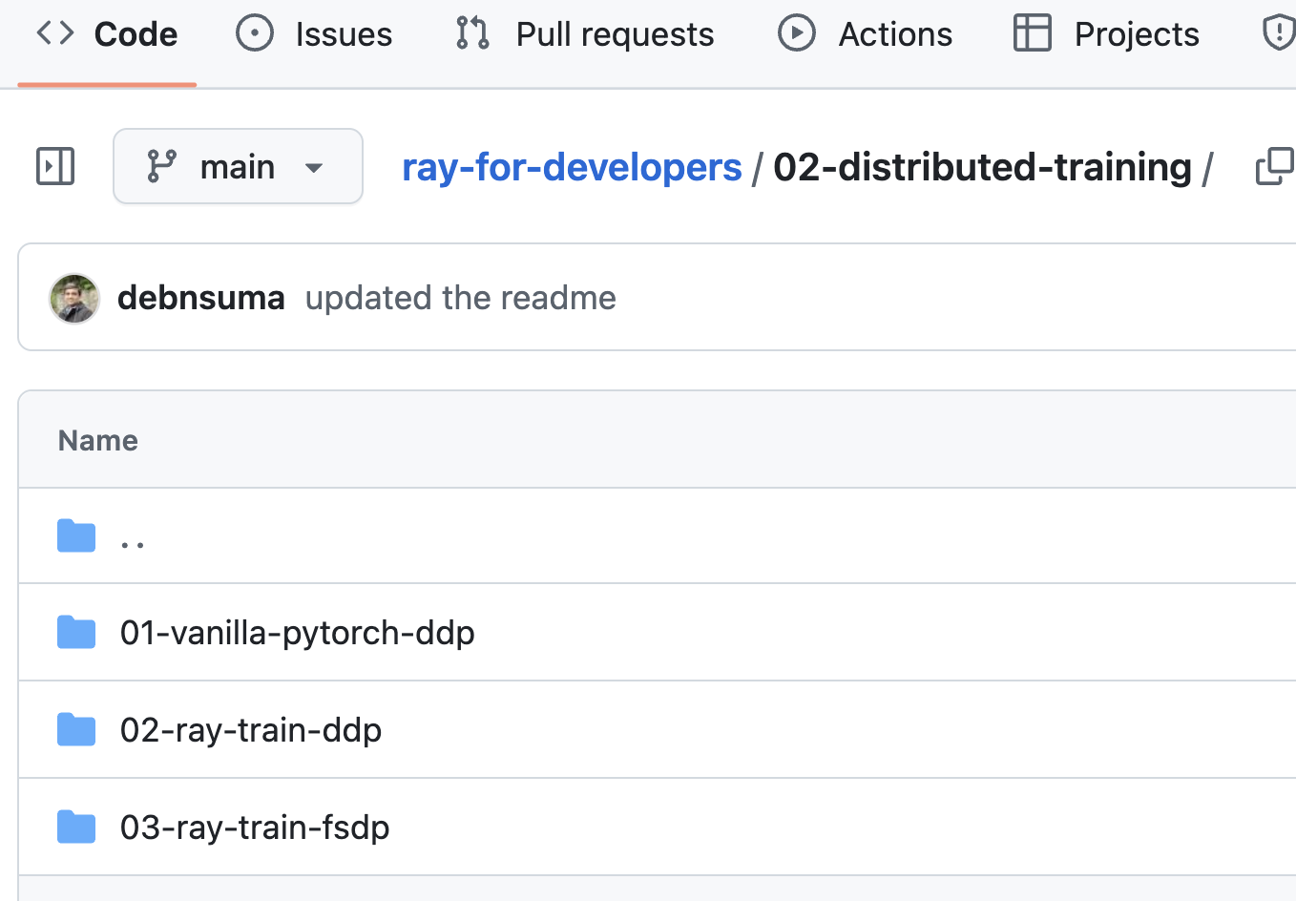
GitHub

Slide 69

The slides
GitHub

Slide 70
THANK YOU.

